Slide 1
Title: Building a Data Integration Pipeline with Mage AI Subtitle: Extracting Data from an API, Transforming it, and Loading into PostgreSQL Your Name: [Your Name] Date: [Date]

Slide 2
Agenda
Content:
Introduction to the Data Pipeline
Step 1: Load Data from API
Step 2: Data Transformation
Step 3: Export to PostgreSQL
Conclusion & Future Steps

Slide 3
Introduction to Data Integration
Title: "What is Data Integration?"
Content:
Explanation of data pipelines and their role in business operations.
Overview of Mage AI as a tool for creating data integration pipelines.
Process: Extract → Transform → Load (ETL).

Slide 4
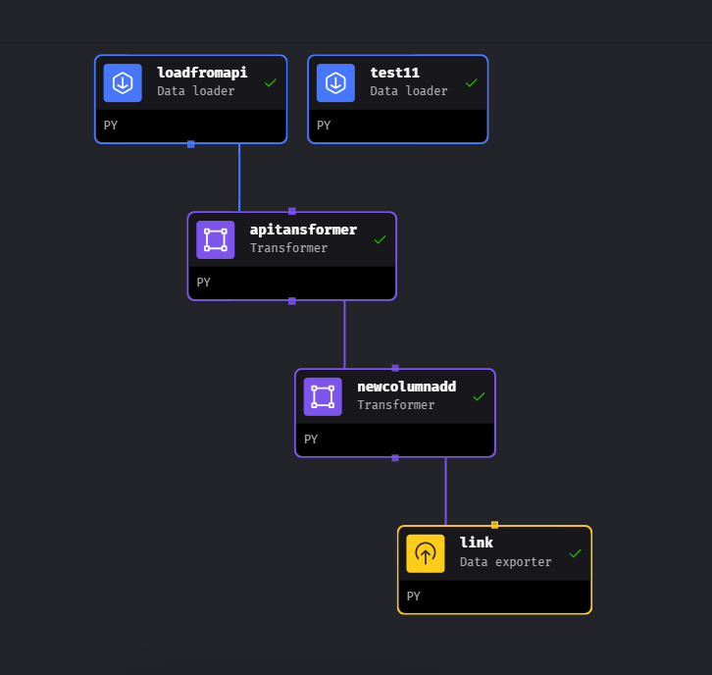

Slide 5
Step 1: Load Data from API"
Content:
Using the API endpoint: https://restcountries.com/v3.1/all.
Description of the API data (country info, capital, region, population, etc.).
Code block example (importing requests, using requests.get(), and returning data as a DataFrame).

Slide 6
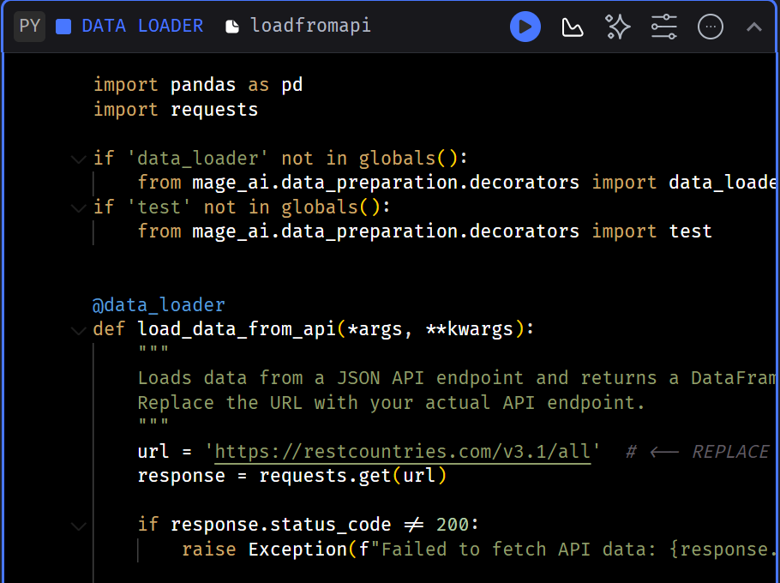

Slide 7
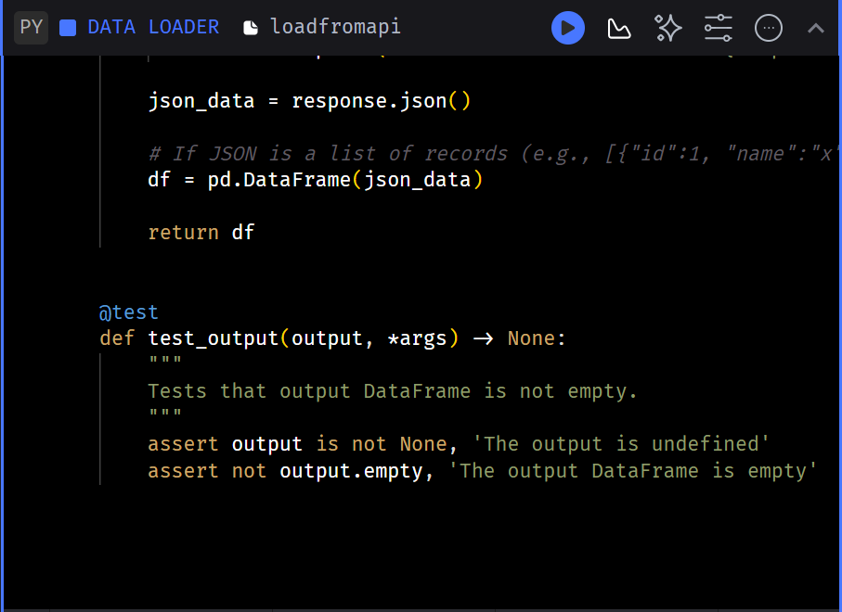

Slide 8
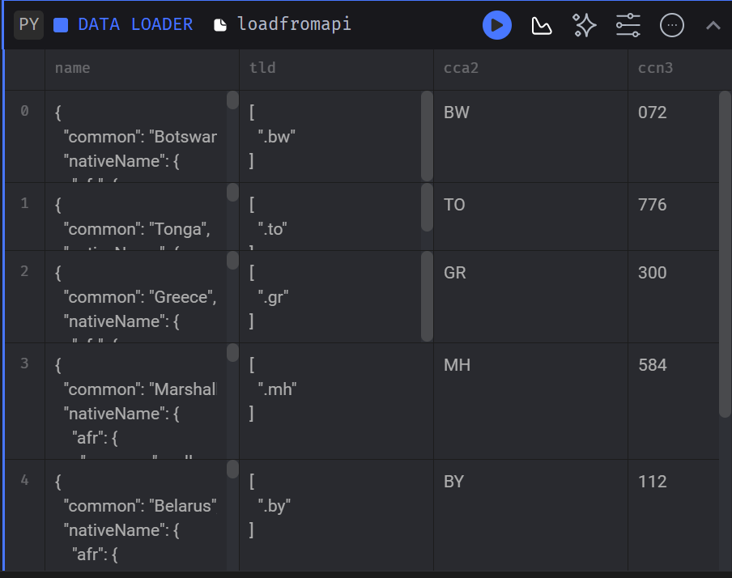

Slide 9
Sample Data from API
Content:
Show a few rows from the API response (e.g., country name, population, region).
Example output:
json
{
"name": {"common": "Australia"},
"capital": ["Canberra"],
"region": "Oceania",
"subregion": "Australia and New Zealand",
"population": 25687041,
"area": 7692024.0
}

Slide 10
Step 2: Data Transformation
Content:
Explanation of transforming the raw API data into a clean, usable format.
Columns created: country_name, capital, region_name, subregion, population, population_millions, area_density.
Code block example (using apply() for custom columns like is_in_asia and area_density).

Slide 11
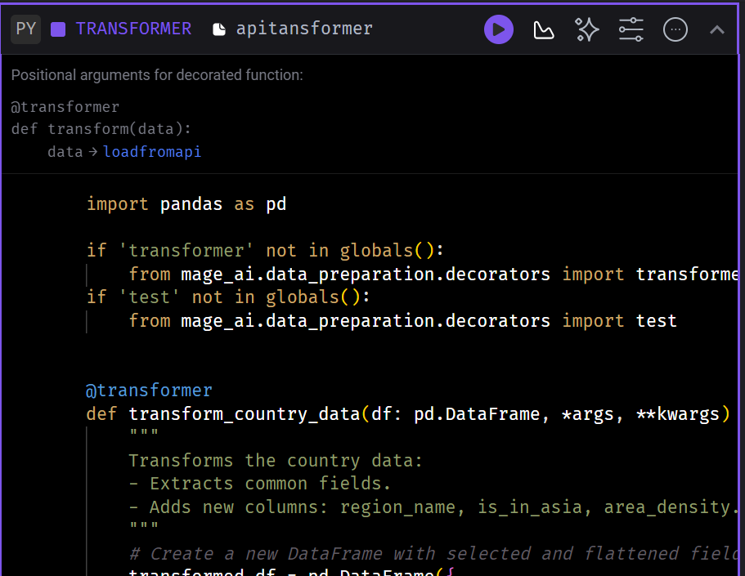

Slide 12
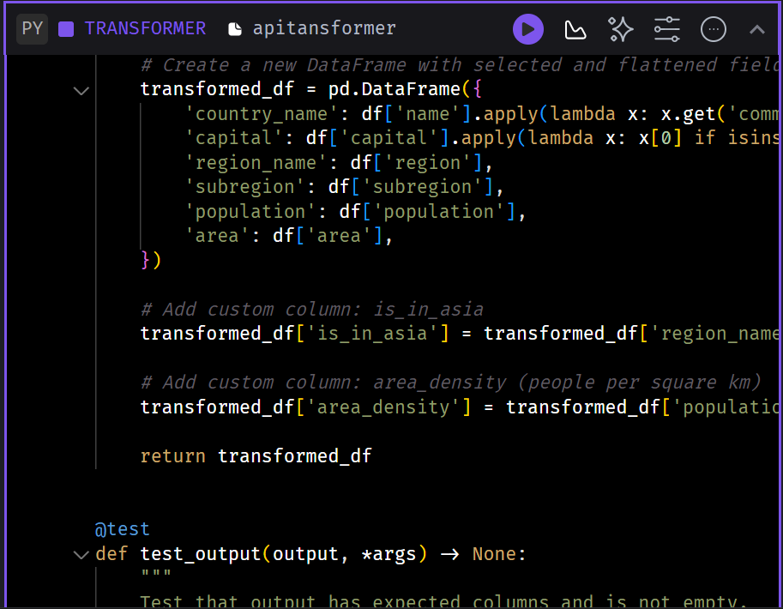

Slide 13
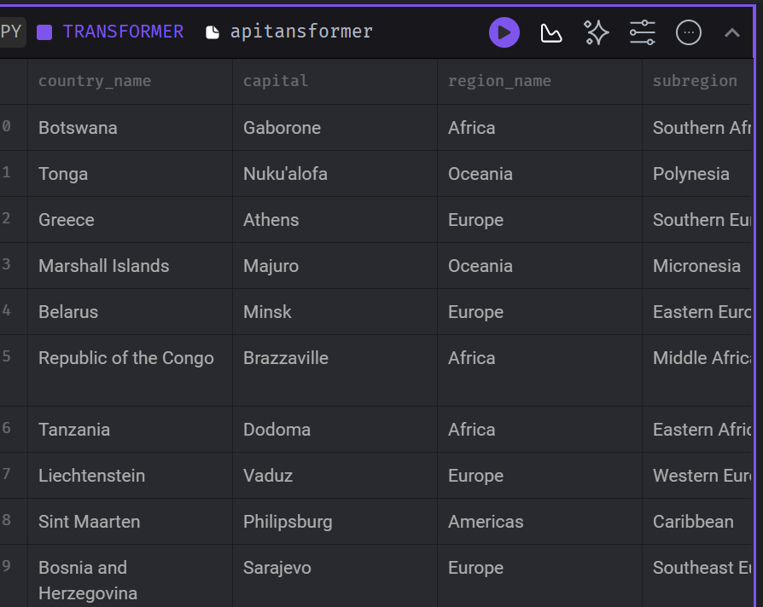

Slide 14
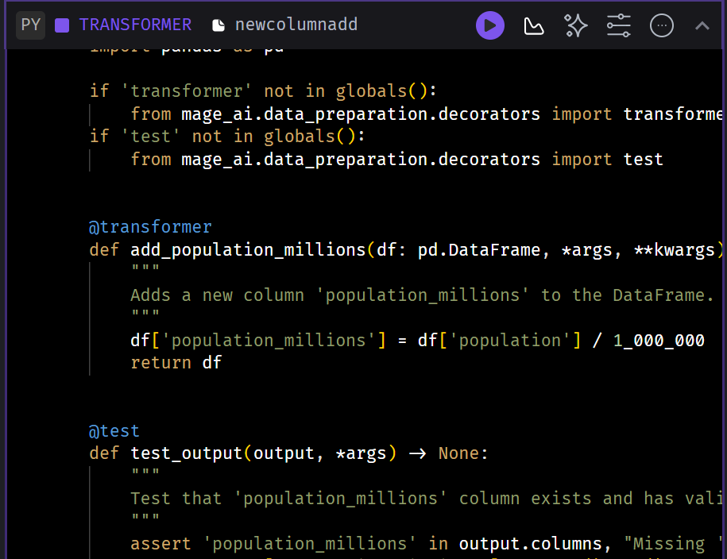

Slide 15
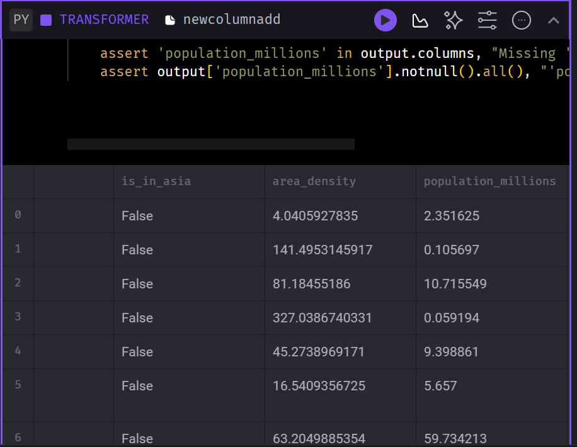

Slide 16
Step 3: Exporting Data to PostgreSQL"
Content:
Description of the database connection and table setup.
Code block for exporting data using to_sql() from pandas.
Specify connection settings (host, port, db name, etc.).
Example PostgreSQL query to create the table with columns.

Slide 17
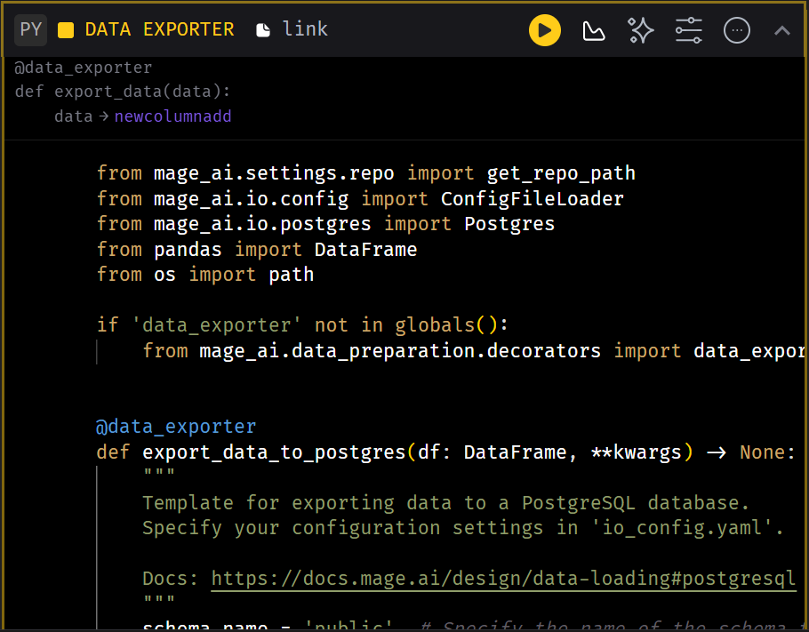

Slide 18
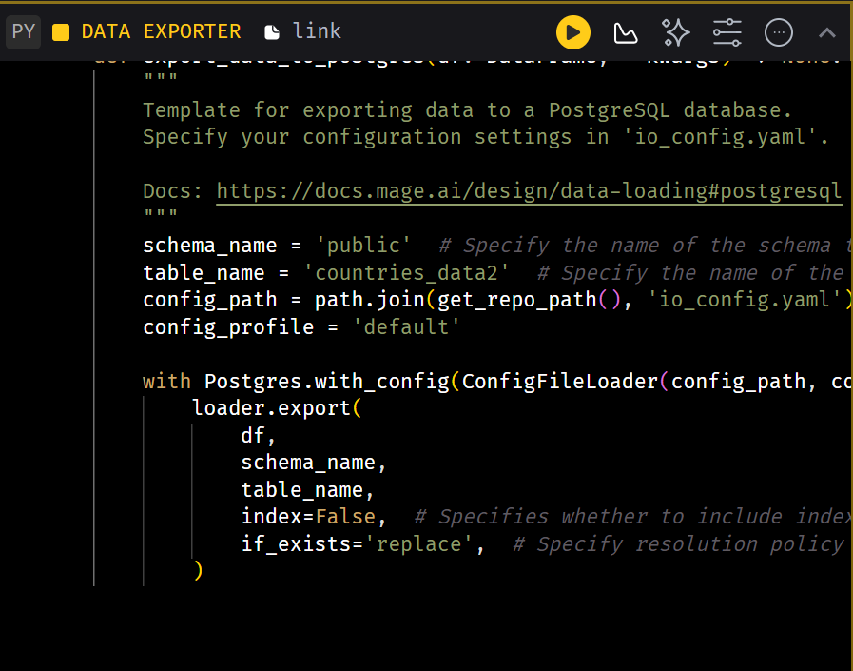

Slide 19
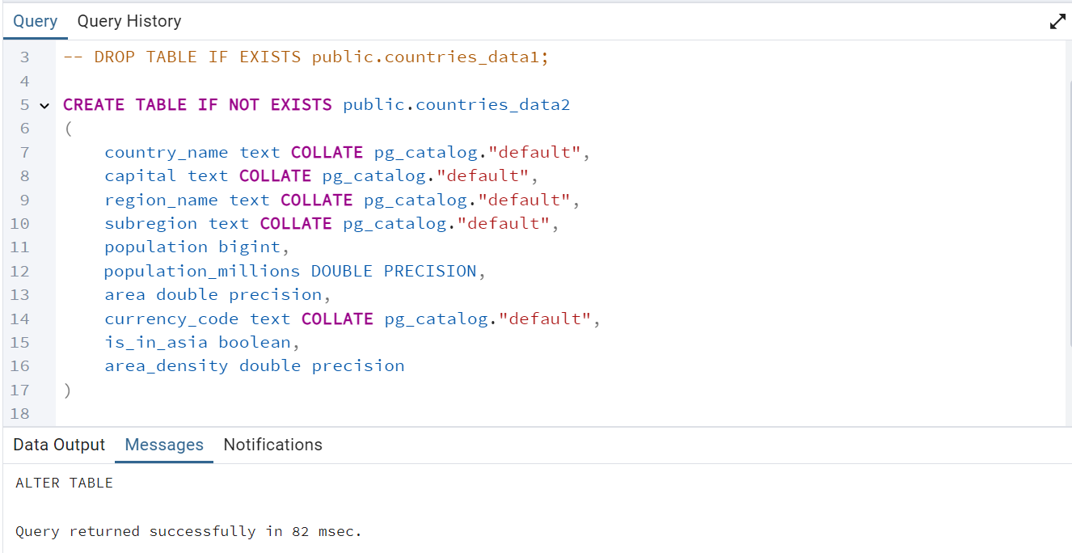
Creating the PostgreSQL Table
Content:
Show SQL CREATE TABLE statement.
Example of the table schema with columns like country_name, population, population_millions, etc.
sql

Slide 20
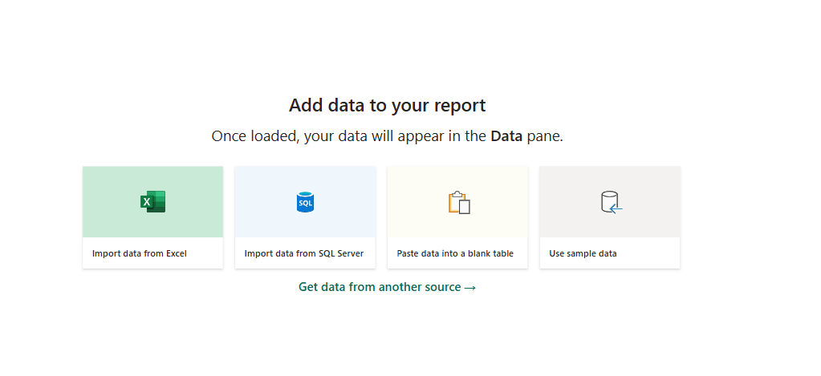

Slide 21
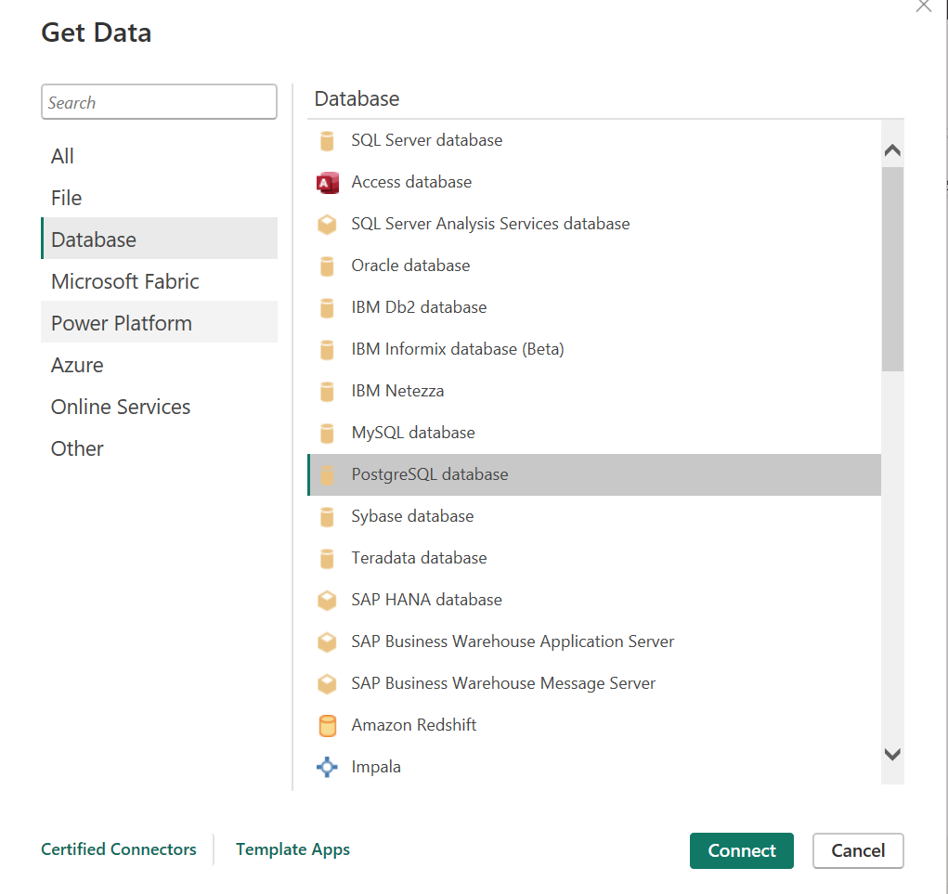
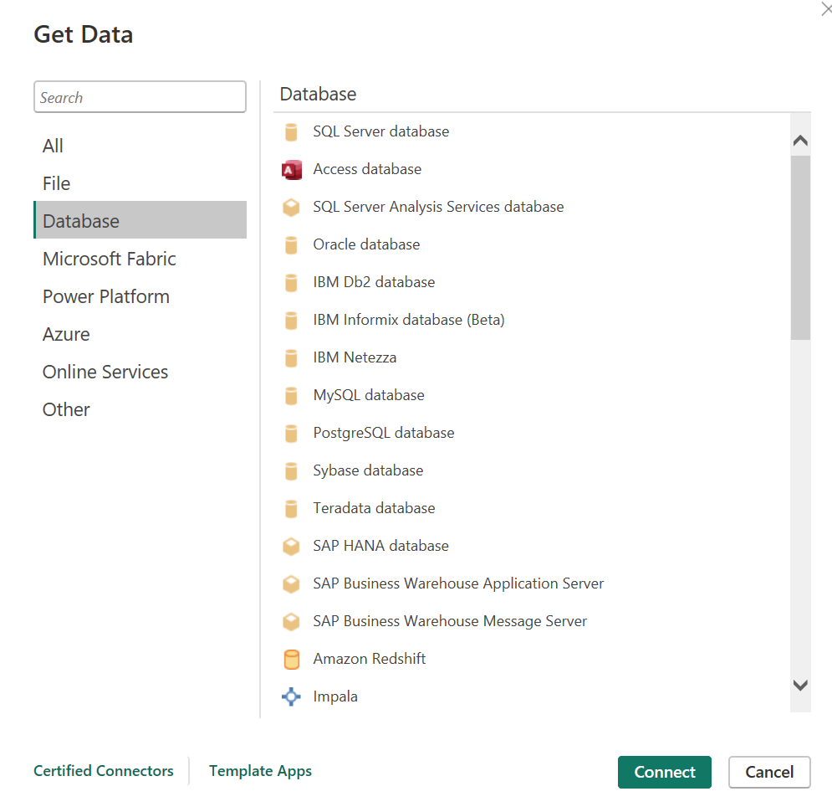

Slide 22
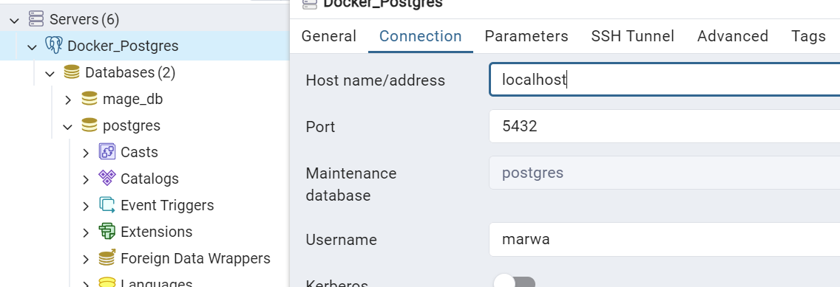
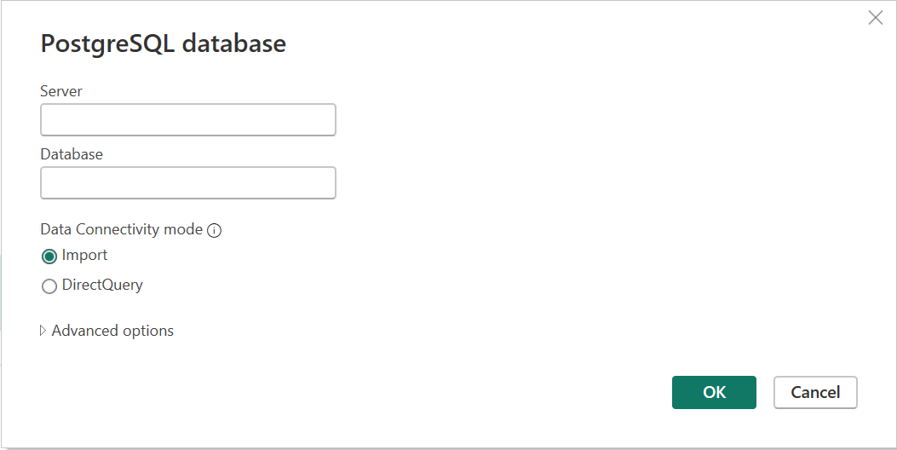

Slide 23
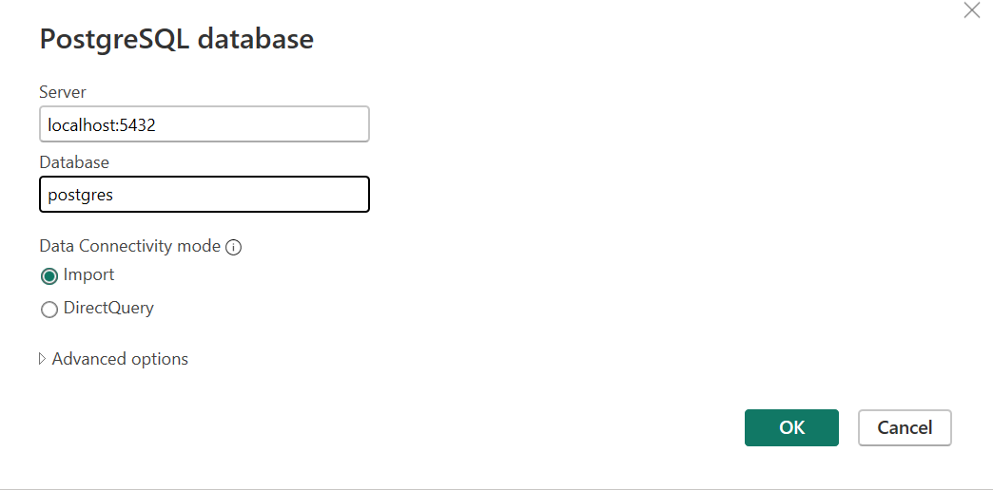
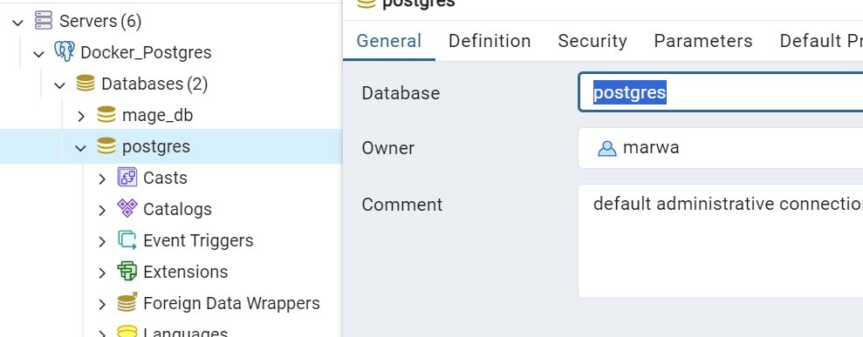

Slide 24
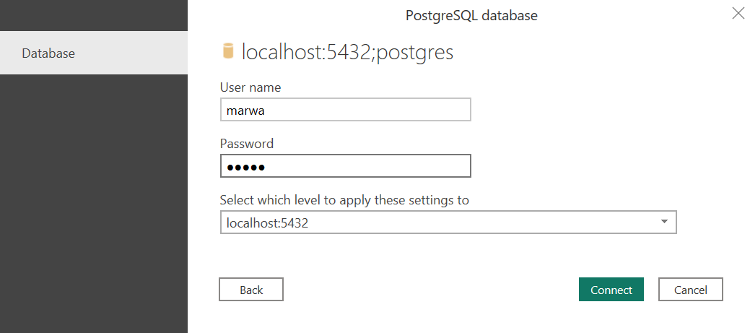

Slide 25
